Slide 1
Unelmate multimeediaarvuti
Jekaterina rätsep
titgv20

Slide 2

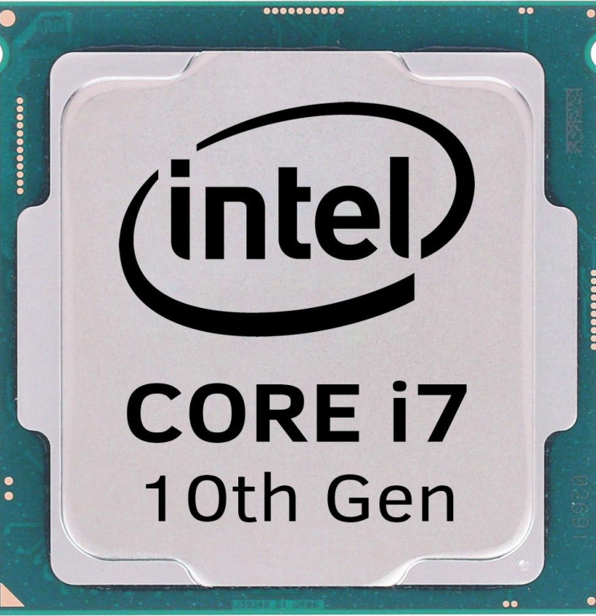
Protsessor Intel i7-10700K, 3.8 GHz, LGA1200
Protsessori mudel: i7-10700K
Protsessori pesa: LGA1200
Protsessorituumad: 8
Sagedusvahemik: 3.8-5.10 GHz
Protsessori harud: 16

Slide 3
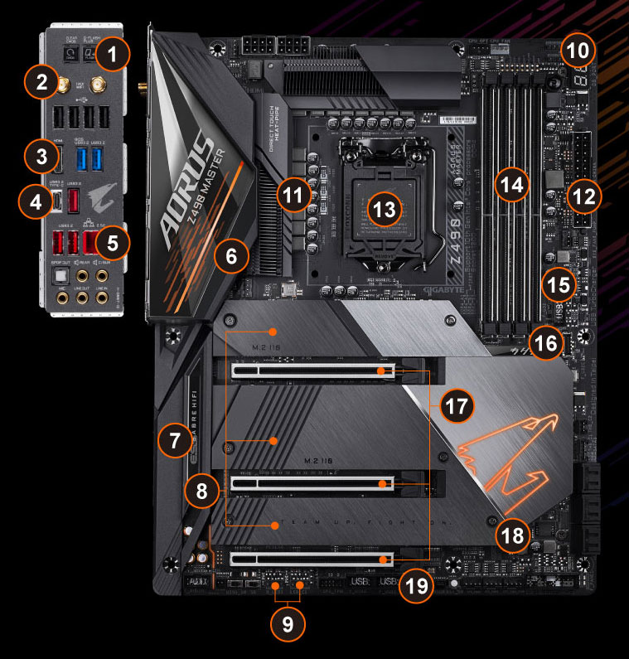
Emaplat GIGABYTE Z490 AORUS MASTER
Product kirjeldus: Gigabyte Z490 AORUS MASTER - 1.X - motherboard - ATX - LGA1200 Socket - Z490
Kiibistiku tüüp: Intel Z490
Protsessor socket: 1 x LGA1200 Socket
Max ram size: 128 GB
Ram supported:4 DIMM slots - DDR4, non-ECC, ECC (operate in non-ECC mode), puhverdamata
Compatible protsessors : Pentium, Celeron, Core i5, Core i3, Core i7, Core i9 (supports 10th Generation Intel Core / Pentium / Celeron)
Storage ports: 6 x SATA-600 (RAID), 3 x M.2
Max allocated ram size 512 MB

Slide 4
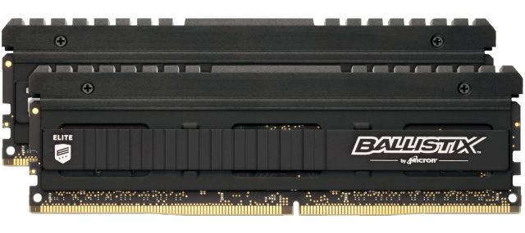
Operatiivmälu DDR4 Crucial Ballistix Elite 16GB (2x8GB) 2666MHz
Tootegrupp: SDR/DDR/DDR2/DDR3/DDR4 memory
Mälu tüüp: puhverdamata, Dual Rank
Mälumaht: 16384 MB
Mälu bus sagedus: 2666 MHz
Memories komplektis: 2
Cas latency (cl): CL16

Slide 5
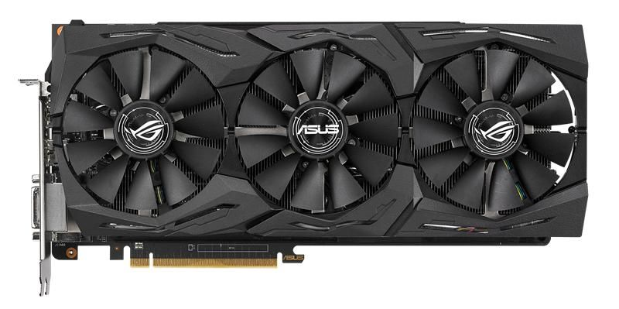
Graafikakaart ASUS ROG Strix RX VEGA56
Bus standard: PCI Express 3.0
Video memory: 8GB HBM2
Memory interface: 2048-bit
Interface: DVI Output - Yes x 1 (Native) (DVI-D),HDMI Output - Yes x 2 (Native) (HDMI 2.0), Display Port - Yes x 2 (Native) (Regular DP), HDCP Support – Yes
Power connectors: 2 x 8-pin
Software: ASUS GPU Tweak II & Driver

Slide 6
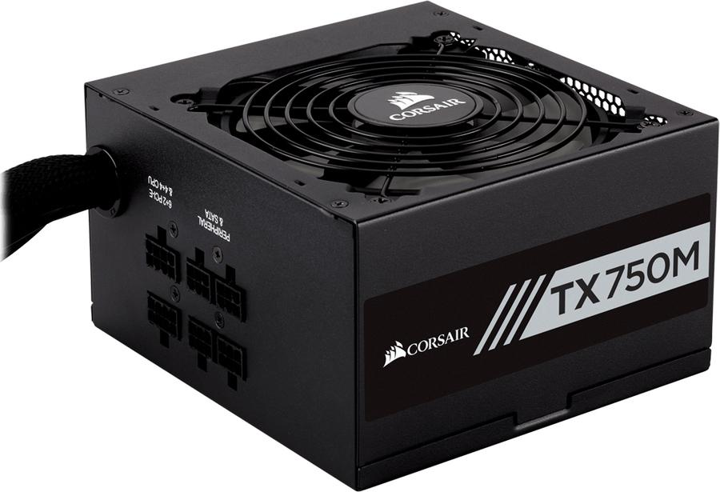
Toiteplokk 750W Corsair TX750M 80+ Gold 750 Watt
Tüüpi + 12V pistik: EPS12V
Formaat: ATX
PFC (Power Factor parandus) tüüp: active
Arv elektri pistikud 4 soonelist (HDD/PAARITU): 7
Arv elektri pistikud 6 + 2-pin (PCI-E): 4
Massmälu tugi: 150

Slide 7
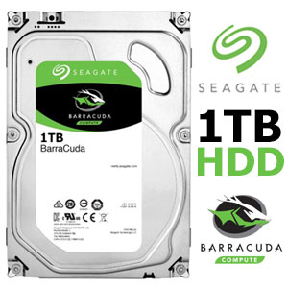
Kõvakettas Seagate Barracuda 1TB SATAIII 7200 RPM, 1000 GB, HDD, 64 MB
Hard drive capacity: 1000 GB
Hard drive speed: 7200 RPM
Hard drive size: 3.5 „
Drive device, buffer size: 64 MB
Hard drive interface: SATA
Device type: HDD

Slide 8
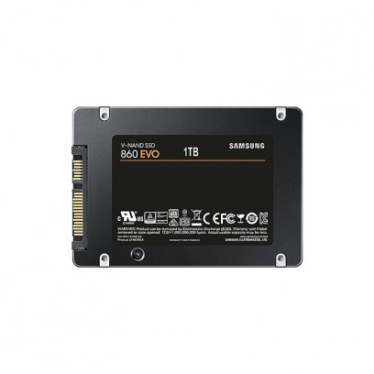
SSD kõvakettas Samsung 860 EVO 1TB 2.5" SATAIII
Capacity: 1TB
Form factor: 2.5„
Interface: SATA III - 6Gb/s
Controller: Samsung MJX
Flash memory type: Samsung V-NAND 3bit MLC
Max. read: 550 MB/s
Max. write: 520 MB/s
Dram cache memory 2GB

Slide 9
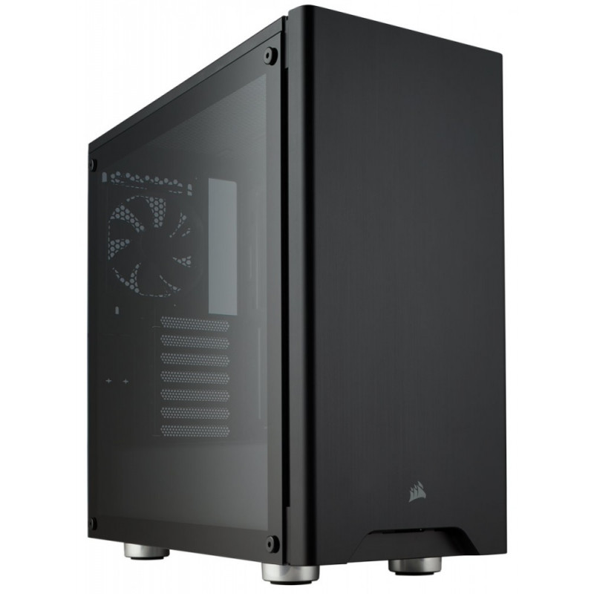
Korpus CORSAIR Carbide 275R - Must / ATX / CPU
Form factor Torn
I/o ühendusi: 2 x USB 3.0; 1 x kõrvaklapid; 1 x microphone
Supported motherboards; ATX, microATX, Mini-ITX
System cabinet features: Windowed side panel, front dust filter, kaabel management holes, meshed top, acrylic side panel, toetab 240 mm radiator in top, PSU dust filters, toetab 280/360 mm radiator in front panel

Slide 10
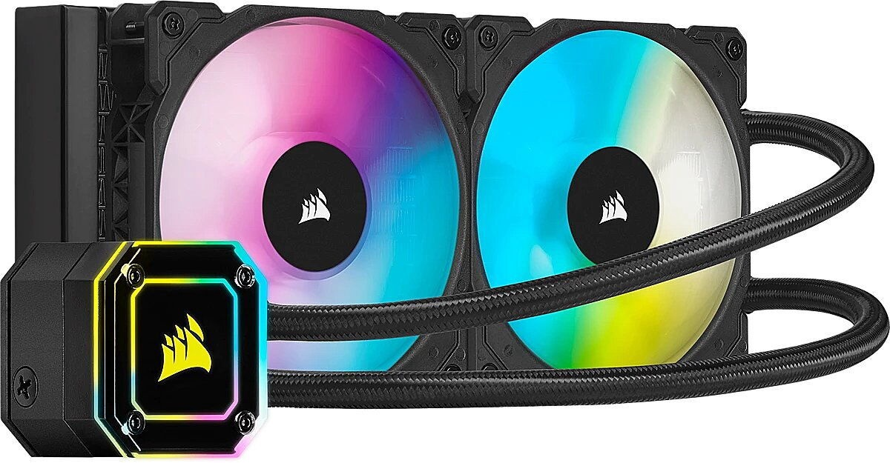
Protsessori jahuti Corsair iCUE H115I Elite Capellix CPU Cooler
Toote tüüp: Vesijahutus
Pistikute tugi : AM3, AM4, AMD Socket TRX4, LGA 1150, LGA 1151, LGA 1155, LGA 1156, LGA 1200, LGA 1366, LGA 2011, LGA 2066, TR4

Slide 11
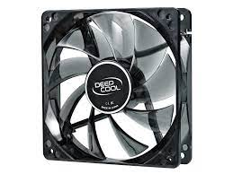
Ventilaator Deepcool WIND BLADE 80 mm
Dimensions 80X80X25mm
Description 4 Blue LEDs, transparent
Fan 1800 + / - 10% RPM

Slide 12
Komponendite hinnad:
Komponent | Hind
Protsessor | 449,97
Emaplaat | 391,91
RAM | 167,84
Graafikakaart | 501,71
Toiteplokk | 92,40
Kõvakettas | 37,90
SSD kõvakettas | 115,20
Korpus | 62,90
Protsessori jahuti | 163,99
Ventilaator | 3,58
Kokku: | 1987,4

